Slide 1
Chapter 6:Servlet
Session Tracking

Slide 2
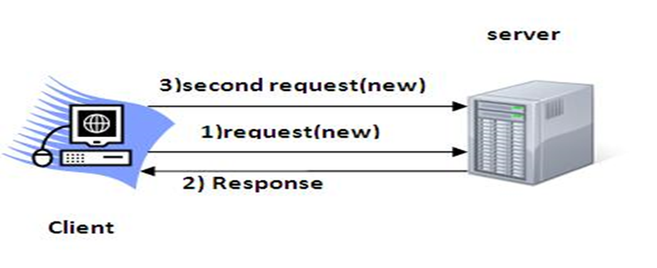
Session Tracking
Session means a particular interval of time.
Session tracking is a way to maintain state data of an user.It is also known as Session management.
Http is a stateless protocol. So we need to maintain state using session tracking technique.
Each time user requests to the server, server treats the request as the new request.
So we need to maintain the state of an user to recognize to particular user.

Slide 3
What is Session Tracking
It is a technique to identify a particular user throughout session.

Slide 4
Session Tracking Techniques
There are four techniques used in Session tracking:
Cookies
Hidden Form Field
URL Rewriting
HttpSession

Slide 5
Cookies
A cookie is a small piece of information that is persisted between the multiple client requests.
A cookie has a name, a single value, and optional attributes such as a comment, path and domain qualifiers, a maximum age, and a version number.

Slide 6
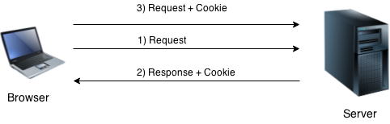
How Cookie works
By default, each request is considered as a new request.
In cookies technique, we add cookie with response from the servlet. So cookie is stored in the cache of the browser. After that if request is sent by the user, cookie is added with request by default. Thus, we recognize the user as the old user.

Slide 7
Types of Cookie
There are 2 types of cookies in servlets.
Non-persistent cookie
Persistent cookie
Non-persistent cookie
It is valid for single session only. It is removed each time when user closes the browser.
Persistent cookie
It is valid for multiple session . It is not removed each time when user closes the browser. It is removed only if user logout or signout.

Slide 8
Advantage & Disadvantage of Cookies
Advantage
Simplest technique of maintaining the state.
Cookies are maintained at client side.
Disadvantage
It will not work if cookie is disabled from the browser.
Only textual information can be set in Cookie object.

Slide 9
Hidden Form Field
In case of Hidden Form Field a hidden (invisible) textfield is used for maintaining the state of an user.
In such case, we store the information in the hidden field and get it from another servlet.
<input type="hidden" name="uname" value="Vimal Jaiswal">
Here, uname is the hidden field name and Vimal Jaiswal is the hidden field value.
This approach is better if we have to submit form in all the pages and we don't want to depend on the browser.
It is widely used in comment form of a website. In such case, we store page id or page name in the hidden field so that each page can be uniquely identified.

Slide 10
Advantage & Disadvantage of Hidden Form Field
Advantage
It will always work whether cookie is disabled or not.
Disadvantage
It is maintained at server side.
Extra form submission is required on each pages.
Only textual information can be used.

Slide 11
Example of Hidden form field
hidden.html
<html>
<form name="Hidden" method="post" action="/servletpgm/Session1">
<input type="text" name="userName" value="">
<input type="submit" value="Click here">
</html>
web.xml
<servlet>
<servlet-name>Ninenth</servlet-name>
<servlet-class>Session1</servlet-class>
</servlet>
<servlet-mapping>
<servlet-name>Ninenth</servlet-name>
<url-pattern>/Session1</url-pattern>
</servlet-mapping>
<servlet>
<servlet-name>Tenth</servlet-name>
<servlet-class>Session2</servlet-class>
</servlet>
<servlet-mapping>
<servlet-name>Tenth</servlet-name>
<url-pattern>/Session2</url-pattern>
</servlet-mapping>

Slide 12
Cont...
Session1.java
import java.io.*;
import javax.servlet.*;
import javax.servlet.http.*;
public class Session1 extends HttpServlet
{
public void doPost(HttpServletRequest req,HttpServletResponse res)throws ServletException,IOException
{
res.setContentType("text/html");
PrintWriter w=res.getWriter();
String uName=req.getParameter("userName");
w.println("Welcome "+uName);
w.println("<form method='get' action='Session2'>");
w.println("<input type='hidden' name='uname' value='"+uName+"'>");
w.println("<input type='submit' value='Goto Session2'>");
w.println("</form>");
w.close();
}
}

Slide 13
Cont...
Session2.java
import java.io.*;
import javax.servlet.*;
import javax.servlet.http.*;
public class Session2 extends HttpServlet
{
public void doGet(HttpServletRequest req,HttpServletResponse res)throws
ServletException,IOException
{
res.setContentType("text/html");
PrintWriter w=res.getWriter();
String uName=req.getParameter("uname");
w.println("Hello "+uName);
w.println("You came here using hidden form field");
w.close();
}
}

Slide 14
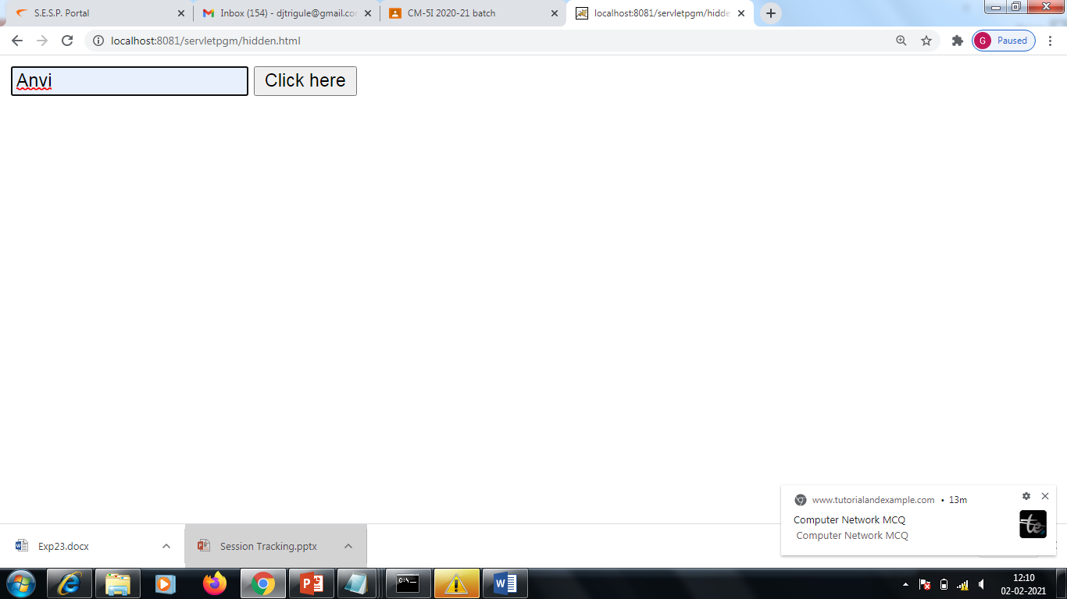
Output

Slide 15
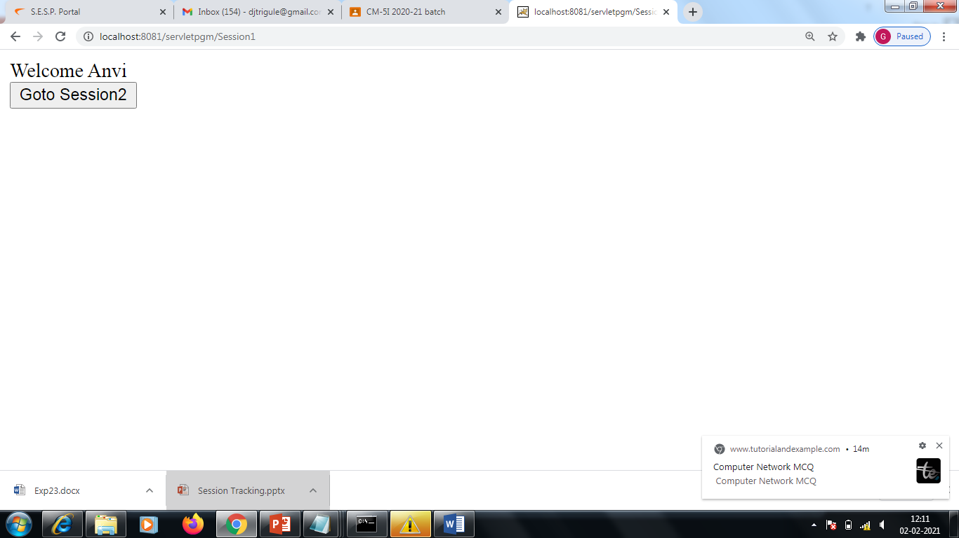
Output

Slide 16
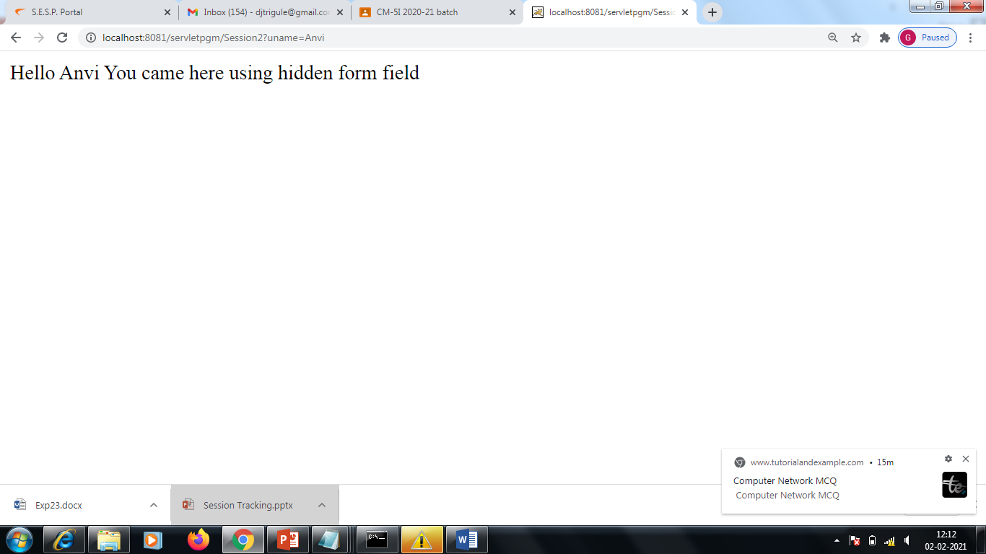
Output

Slide 17
URL Rewriting
In URL rewriting, we append a token or identifier to the URL of the next Servlet or the next resource.
We can send parameter name/value pairs using the following format:
url?name1=value1&name2=value2&??
Use <a href=‘url?name1=value1&name2=value2’> tag.
When the user clicks the hyperlink, the parameter name/value pairs will be passed to the server.
From a Servlet, we can use getParameter() method to obtain a parameter value.

Slide 18
Advantage & Disadvantage of URL Rewriting
Advantage
It will always work whether cookie is disabled or not (browser independent).
Extra form submission is not required on each pages.
Disadvantage
It will work only with links.
It can send Only textual information.

Slide 19
Example
urlrewrite.html
<html>
<form name="url Rewrite" method="post"
action="/servletpgm/Url1">
First Name:
<input type="text" name="firstName" value="">
</br>
Last Name:
<input type="text" name="lastName" value="">
</br>
<input type="submit" value="Click here">
</html>

Slide 20
Example
web.xml
<servlet>
<servlet-name>UrlRewrite</servlet-name>
<servlet-class>Url1</servlet-class>
</servlet>
<servlet-mapping>
<servlet-name>UrlRewrite</servlet-name>
<url-pattern>/Url1</url-pattern>
</servlet-mapping>
<servlet>
<servlet-name>UrlRewrite2</servlet-name>
<servlet-class>Url2</servlet-class>
</servlet>
<servlet-mapping>
<servlet-name>UrlRewrite2</servlet-name>
<url-pattern>/Url2</url-pattern>
</servlet-mapping>

Slide 21
Example
Url1.java
import java.io.*;
import javax.servlet.*;
import javax.servlet.http.*;
public class Url1 extends HttpServlet
{
public void doPost(HttpServletRequest req,HttpServletResponse
res)throws ServletException,IOException
{
res.setContentType("text/html");
PrintWriter w=res.getWriter();
String firstName=req.getParameter("firstName");
String lastName=req.getParameter("lastName");
w.println("Welcome "+firstName);
w.println("<a href='Url2?firstName="+firstName+"&lastName="+lastName+"'>Visit</a>");
w.close();
}
}

Slide 22
Example
Url2.java
import java.io.*;
import javax.servlet.*;
import javax.servlet.http.*;
public class Url2 extends HttpServlet
{
public void doGet(HttpServletRequest req,HttpServletResponse res)throws ServletException,IOException
{
res.setContentType("text/html");
PrintWriter w=res.getWriter();
String firstName=req.getParameter("firstName");
String lastName=req.getParameter("lastName");
w.println("Your first name is"+firstName);
w.println("Your last name is"+lastName);
w.close();
}
}

Slide 23
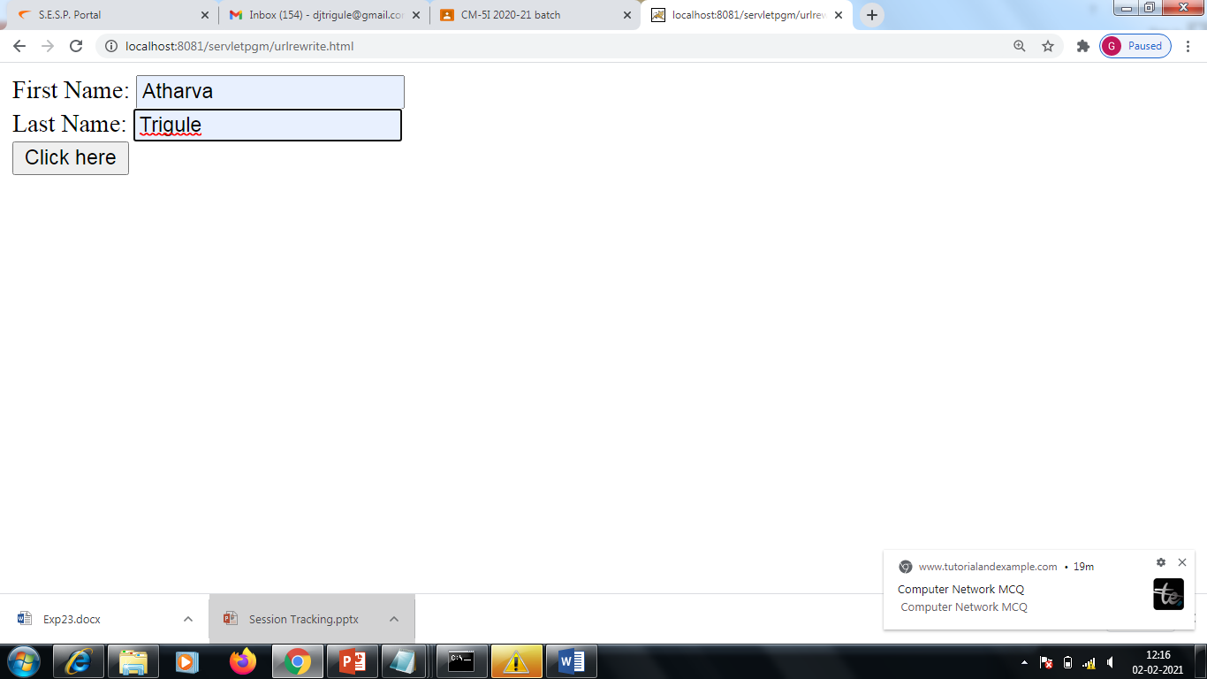
Output

Slide 24
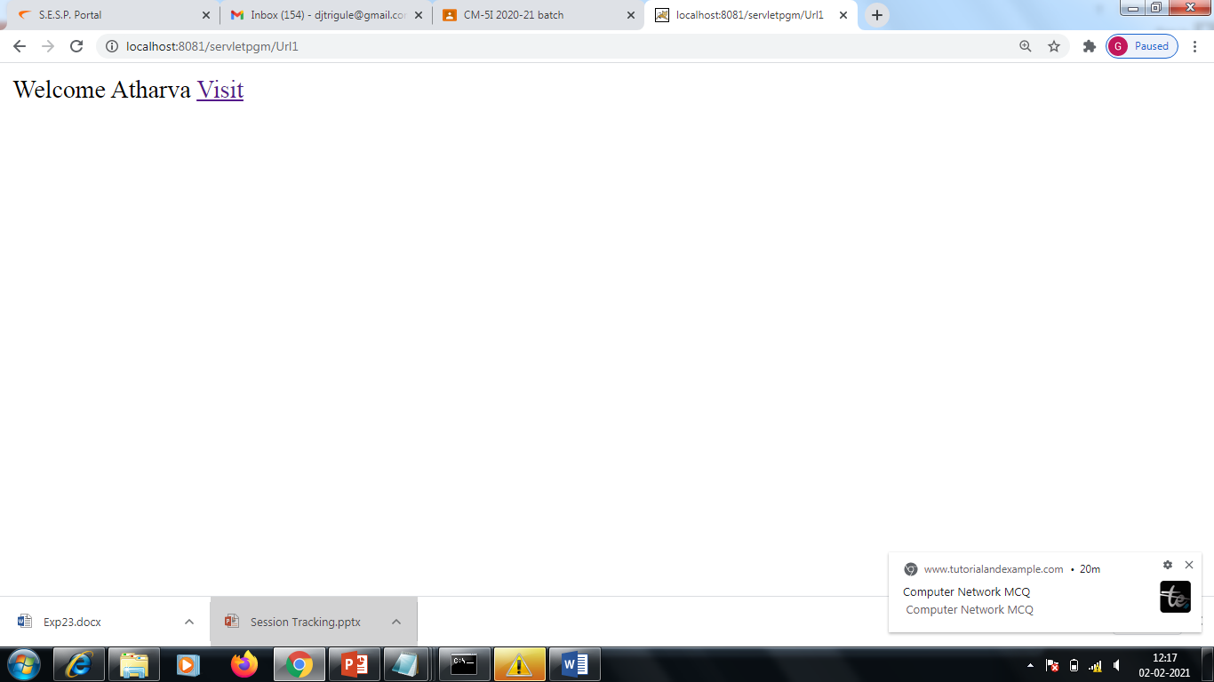
Output

Slide 25

Output

Slide 26
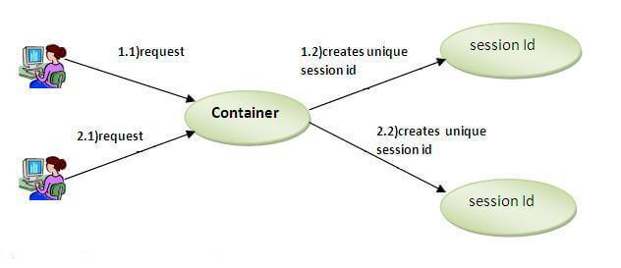
HttpSession
In this technique container creates a session id for each user . The container uses this id to identify the particular user.

Slide 27
Cont..
A session can be created via the getSession( ) method of HttpServletRequest . An HttpSession object is returned.
This object can store a set of bindings that associate names with objects. The putValue( ), getValue( ), getValueNames( ), and removeValue( )methods of HttpSession manage these bindings.
It is important to note that session state is shared among all the servlets that are associated with a particular client.

Slide 28
Advantage & Disadvantage of HttpSession
Advantage
Can store any kind of information such as text,integers,datasets,etc.
Not dependent on clients browser.
Secure.
Disadvantage
Stored on Server.

Slide 29
Example
web.xml
<web-app>
<servlet>
<servlet-name>HttpSession</servlet-name>
<servlet-class>DateServlet</servlet-class>
</servlet>
<servlet-mapping>
<servlet-name>HttpSession</servlet-name>
<url-pattern>/Session</url-pattern>
</servlet-mapping>
</web-app>

Slide 30
Example
DateServlet.java
import java.io.*;
import java.util.*;
import javax.servlet.*;
import javax.servlet.http.*;
public class DateServlet extends HttpServlet {
public void doGet(HttpServletRequest request,
HttpServletResponse response)
throws ServletException, IOException {
HttpSession hs = request.getSession(true);
response.setContentType("text/html");
PrintWriter pw = response.getWriter();
pw.print("<B>");
Date date = (Date)hs.getValue("date");
if(date != null) {
pw.print("Last access: " + date + "<br>");
}
date = new Date();
hs.putValue("date", date);
pw.println("Current date: " + date+ "<br>");
pw.println("<b>"+"Session ID is"+ hs.getId()+ "<br>");
pw.println("<b>"+"Creation time"+new Date(hs.getCreationTime())+ "<br>");
}
}

Slide 31
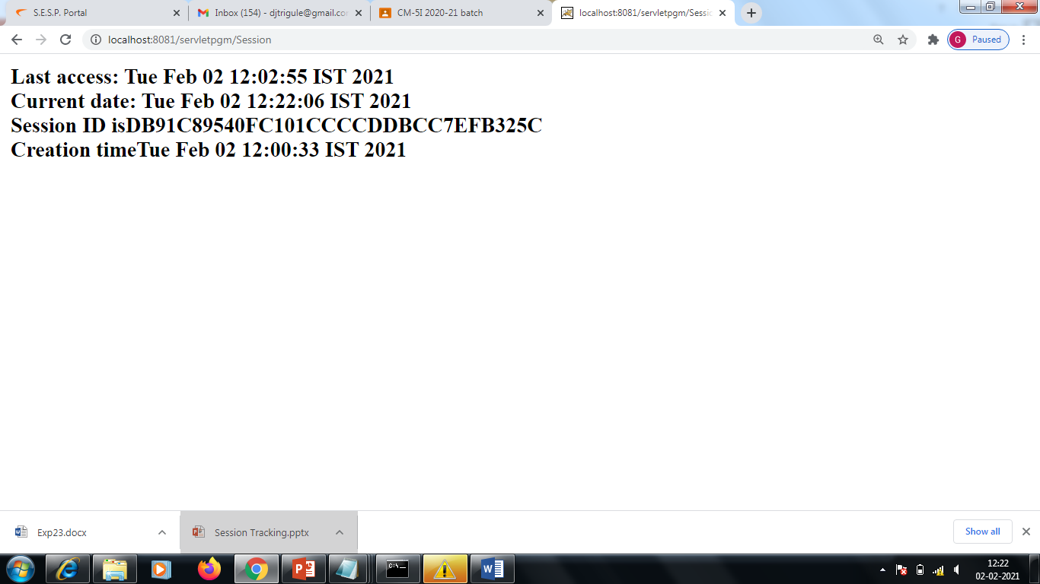
Output

